Slide 1
Presentation 11/03

Slide 2
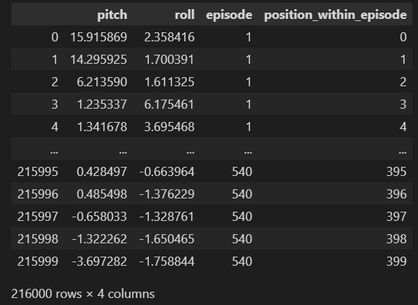


Data discontinuity
Episodes don’t follow chronologically
Ep1: 400th frame Ep2: 1st frame

Slide 3
Data discontinuity
Episodes don’t follow chronologically
Add episode number & position
Batch size = 400?
Ep1: 400th frame Ep2: 1st frame

Slide 4
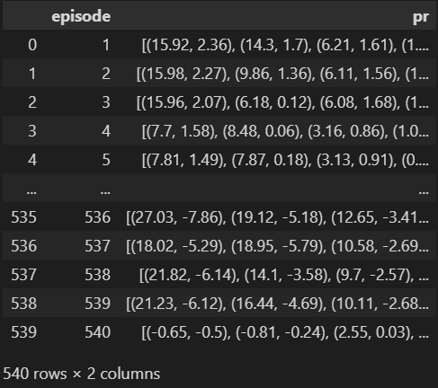
Data discontinuity
Episodes don’t follow chronologically
Add episode number & position
Stack data: each row = episode
Ep1: 400th frame Ep2: 1st frame

Slide 5
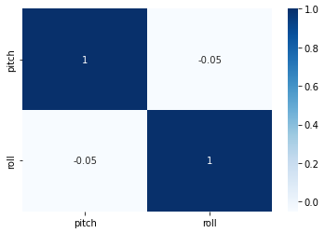
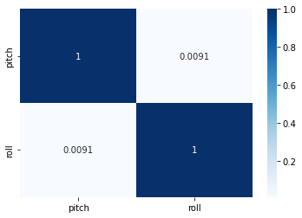
Data preparation
Low correlation between Pitch & Roll
Use both to predict both at the same time
Use both to predict one
One LSTM model for pitch, one for roll
Only use pitch to predict pitch, roll to predict roll
Episode 1 All episodes

Slide 6
Planning March 2022
14/03-20/03
Continue Udemy course
Debug, train, test and evaluate LSTM PR model
21/03-27/03
Continue Udemy course
Create simple CNN model for images
28/03-03/04
Train, test and evaluate CNN model
Combine with PR input
Hybrid with LSTM
Encoder-Decoder
Recreate Nazar’s best models if possible

Slide 7
Planning April 2022
04/04-10/04
Recreate Nazar’s best models
Train, test and evaluate with simulated (and real if available)
11/04-17/04
Debugging
Optimizing
Buffer for problems/delays occurred in previous weeks
18/04-24/04
Compare results simulation-real vs. criteria
Create new model if necessary:
Transformer model
25/04-01/05
Continue new model
Optimize old model
Extensive testing

Slide 8
Planning May 2022
Depends on progression

Slide 9
Planning June 2022
Paper writing
Debugging
Optimizations

